Slide 1
CIS 508 - Machine Learning in Business
Assignment – 1
Done By:
Ishika Gupta - 1229311176

Slide 2
Problem Statement
To perform a binary classification on the Santander dataset to predict if customers are satisfied or not satisfied.
This will help Santander improve their customer’s happiness or satisfaction early on and prevent losing customers.

Slide 3
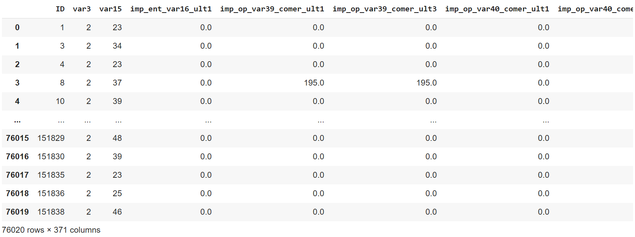
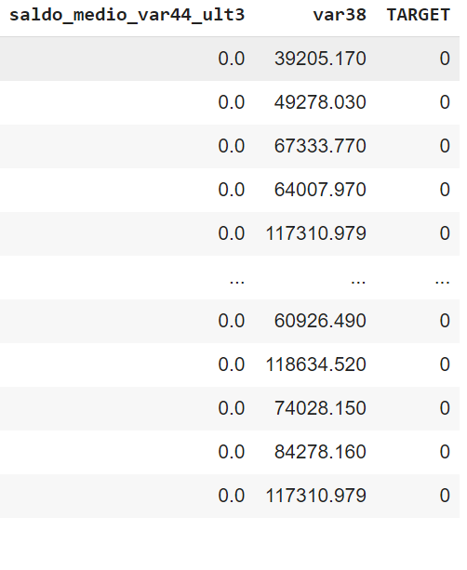
Dataset

Slide 4
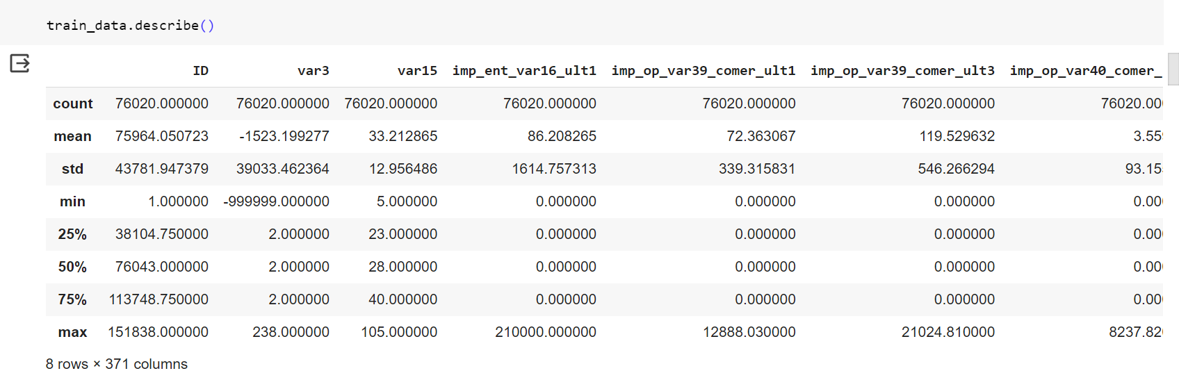
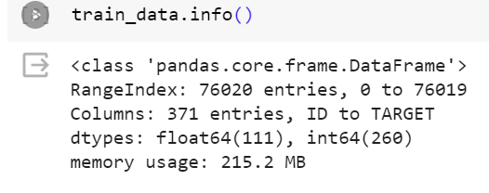
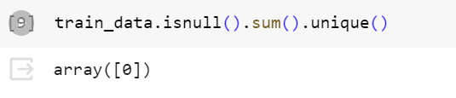
Exploratory analysis
Number of rows: 76020
Number of columns: 371
Anonymous features
Numerical Dataset – 111 floating type columns and 260 int type columns
No missing values

Slide 5
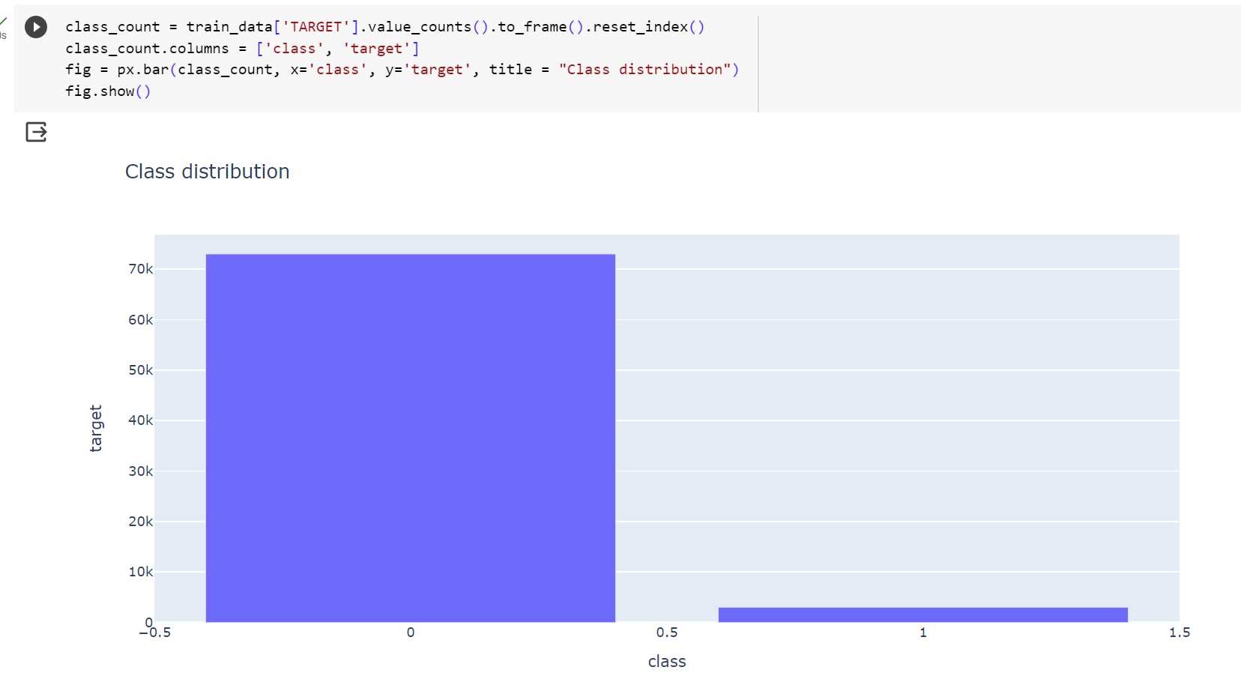
Exploratory analysis
2 unique classes: 0 an 1
Imbalanced Dataset
Number of records for class 0: 73012
Number of records for class 1: 3008
Imbalanced dataset

Slide 6
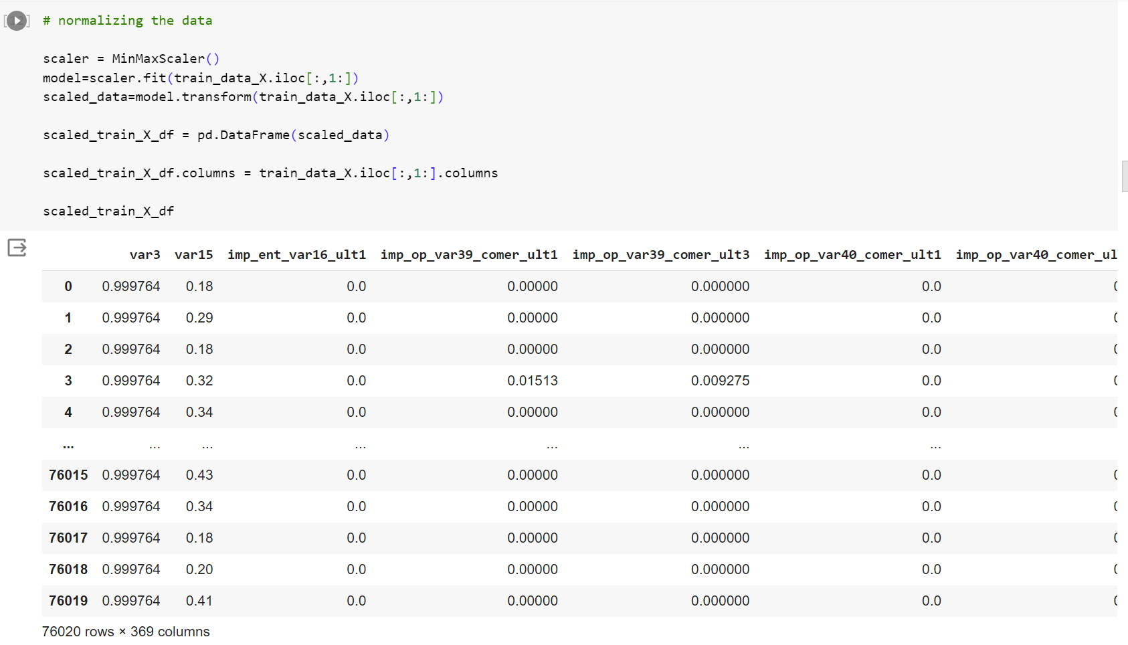
Data preprocessing - Normalizing the data
Min max normalization

Slide 7
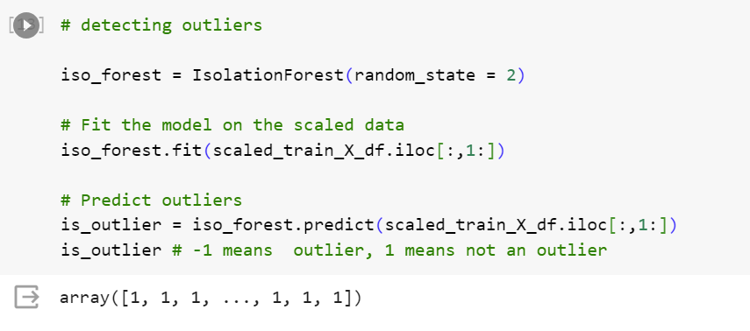
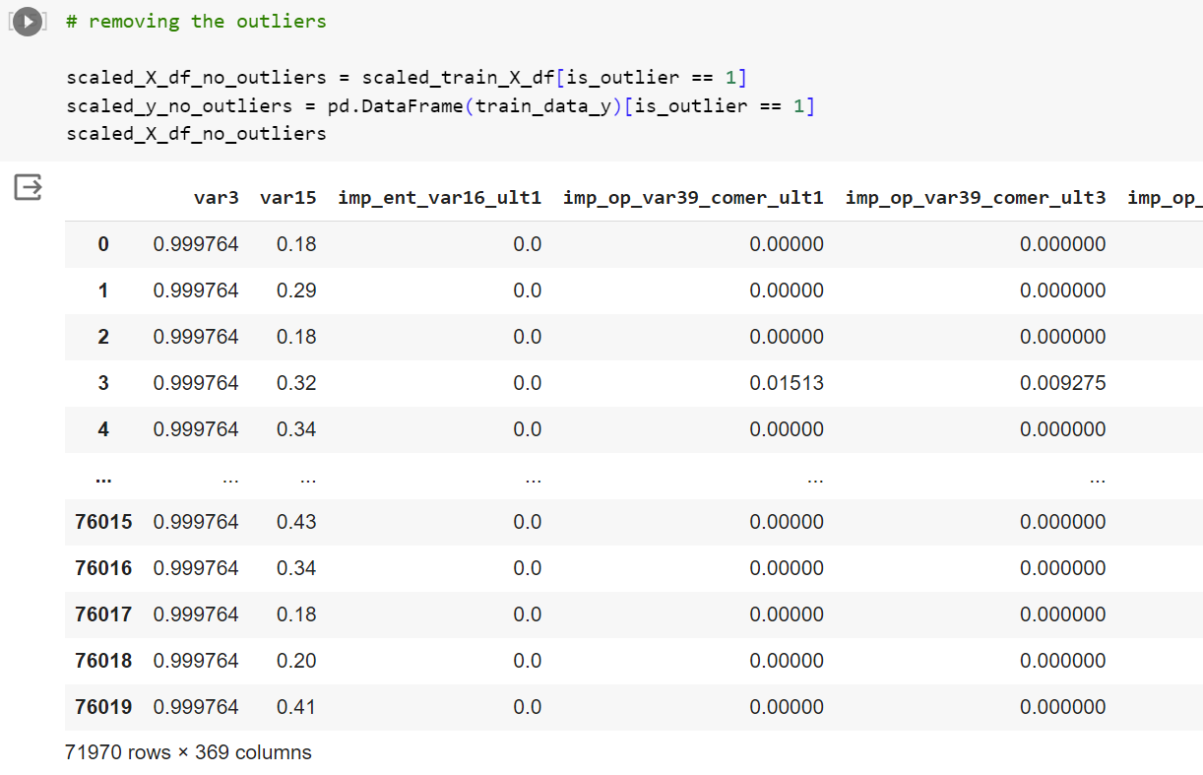
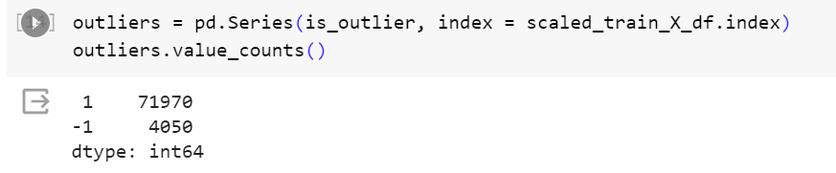
Data Preprocessing – Outlier detection and removal
Number of outliers: 4050 records out of 76020 records (5.33% of the data)

Slide 8
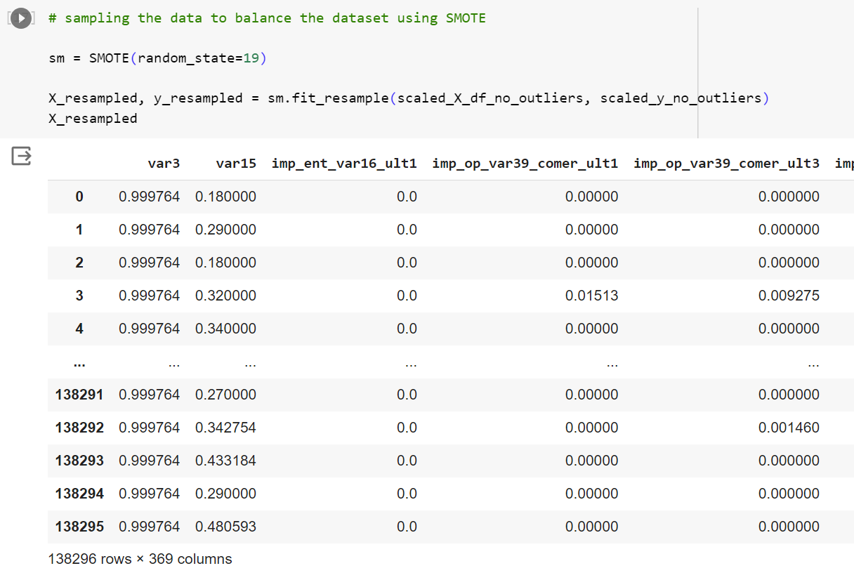
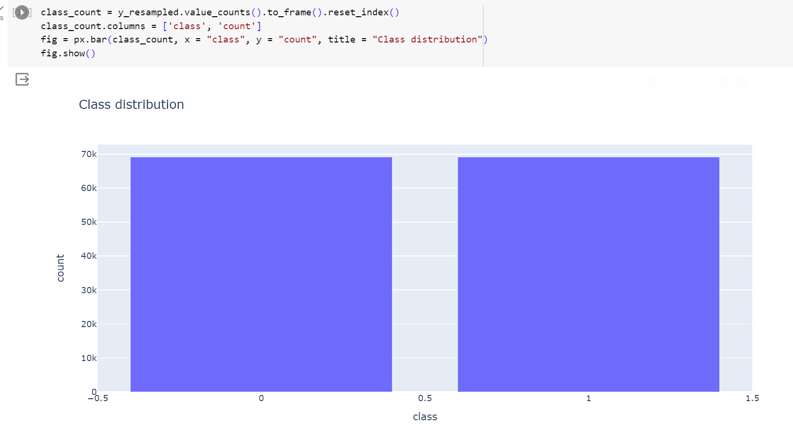
Data preprocessing – Sampling
Performing oversampling using SMOTE to balance the dataset
Total number of records is now: 138296
Equal number of records for each class: 69148

Slide 9
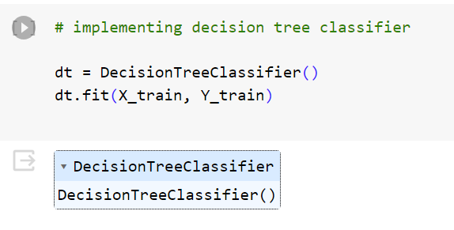
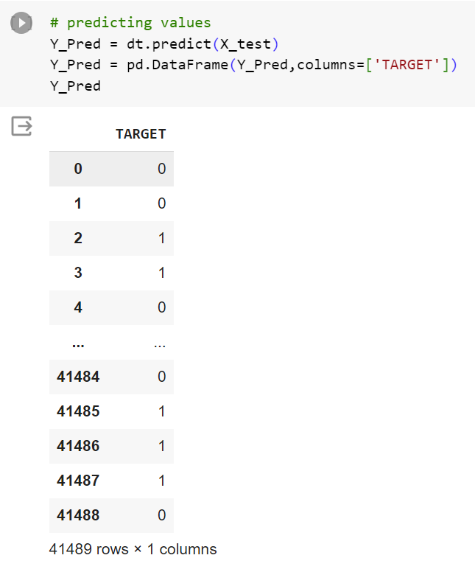
Building and implementing decision tree models – model 1

Slide 10
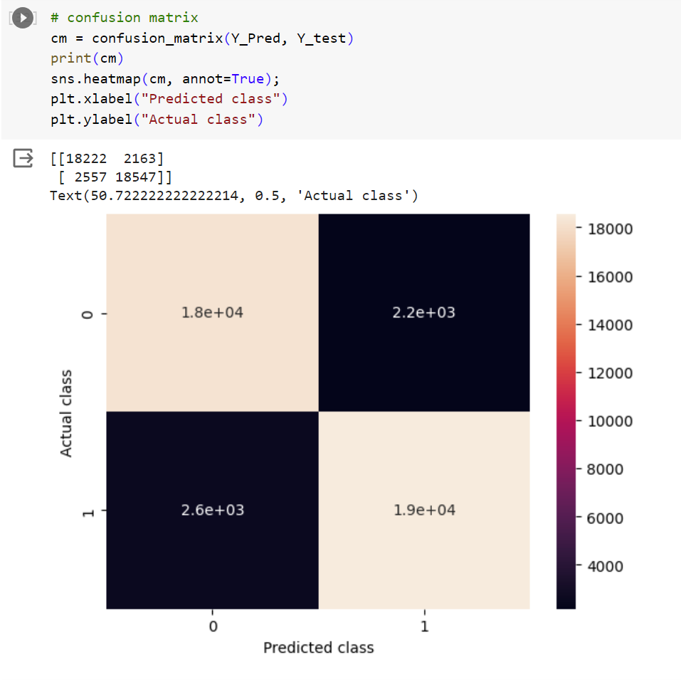
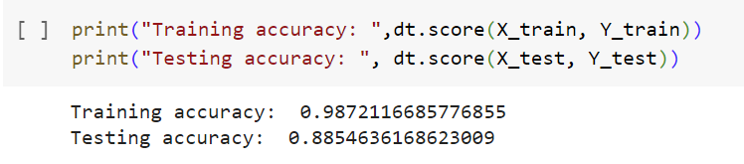
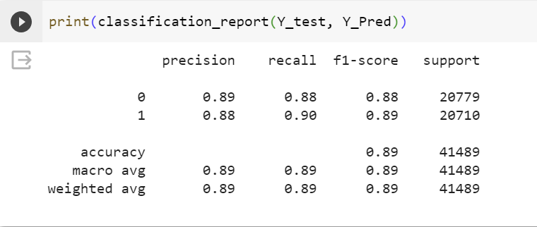
Model 1
Only default parameters used.
Model is overfitting

Slide 11
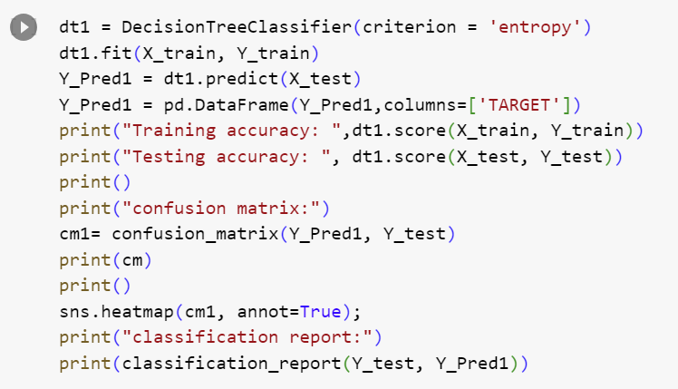
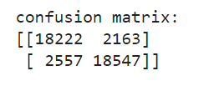
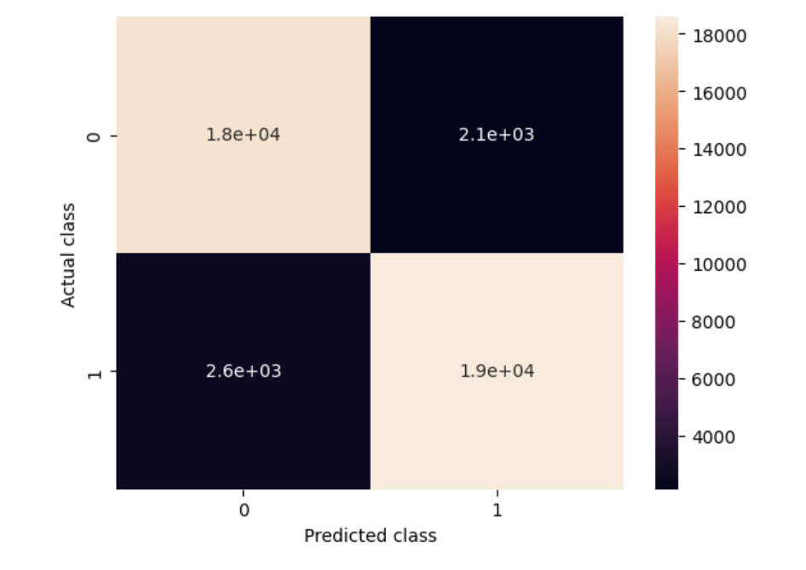

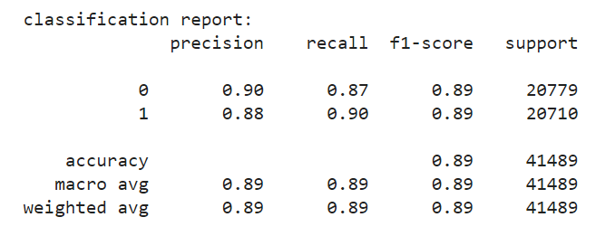
Model 2
Criterion used: entropy
Slight increase in testing accuracy
Model is still overfitting

Slide 12
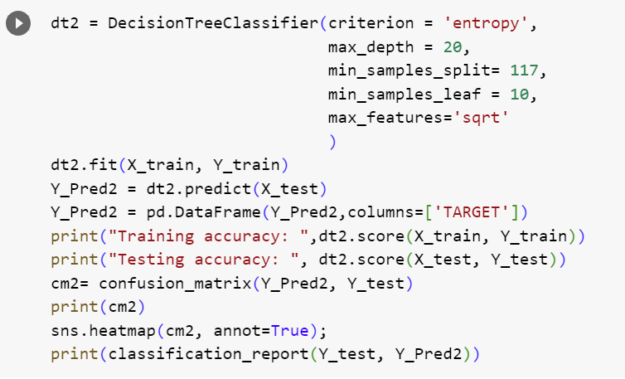

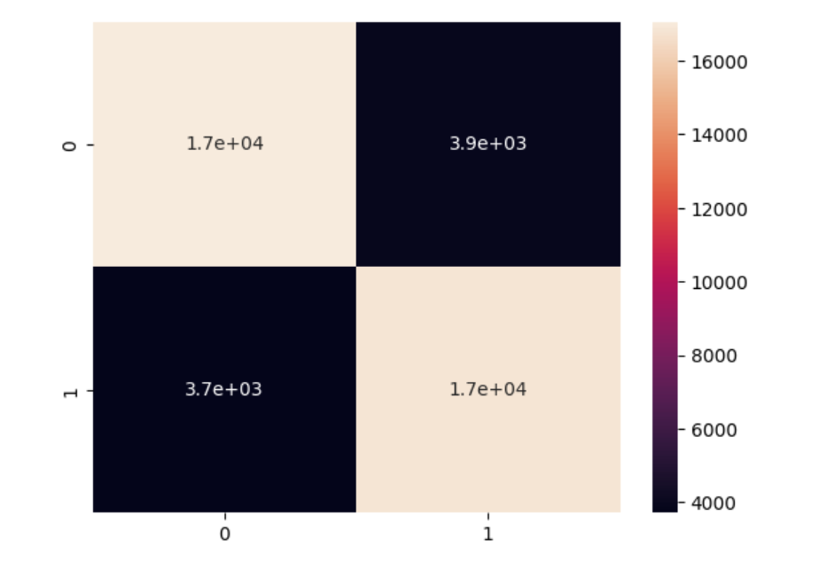

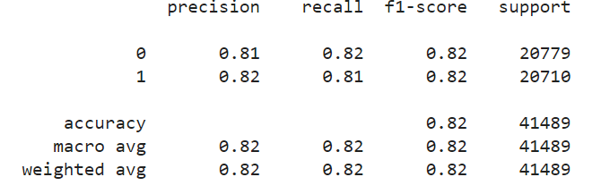
Model 3
Stopped the tree from growing to its full length to reduce overfitting
Final model chosen to make predictions on the test set

Slide 13
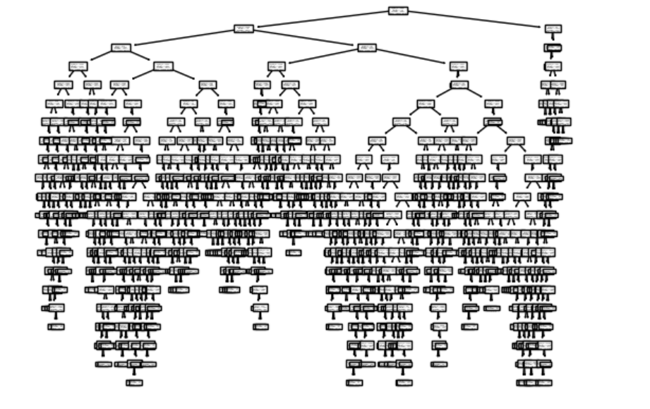
Model 3 – decision tree

Slide 14
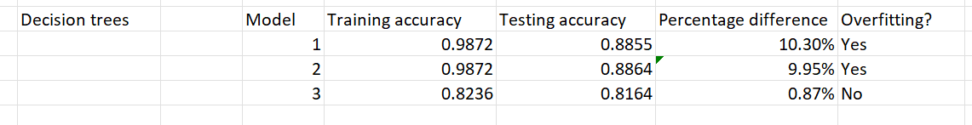
Comparison between models
Best model: Model 3

Slide 15
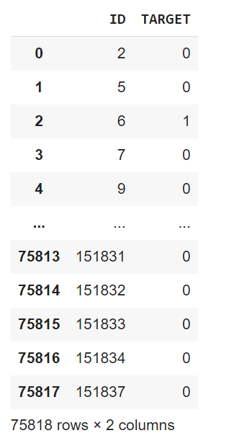
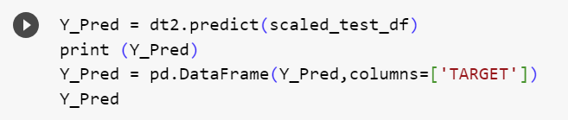
Kaggle test dataset
Kaggle score:
0.68536

Slide 16
Why is this a hard problem from ML point of view?
Anonymous features – Difficulty in feature selection and black box problem
Large number of features – Increase in computational complexity and development time
Large and anonymous features – Difficulty in data exploration and visualization

Slide 17
Thank You

